Slide 1

Delete before presenting Please read the instruction given in this section
This PowerPoint template is intended for use in creating new slide decks from scratch: all slide layouts can be accessed and applied in the Home > Layout toolbar. It also serves as the vehicle for importing old slides into the new format.
To get started, please download and review the multiple GBIF PowerPoint Toolkits available, which are located in this GitHub repository. These presentations provide instructions on how to use and customize various design elements consistently in this template and across your presentations, e.g. changing the map on a title slide, etc.
The files also provide access to additional graphic elements—such as tables, charts, icons, editable maps, quote boxes, photo grids, icons, infographics, collages, and timelines.
Notes:
Notes

Slide 2
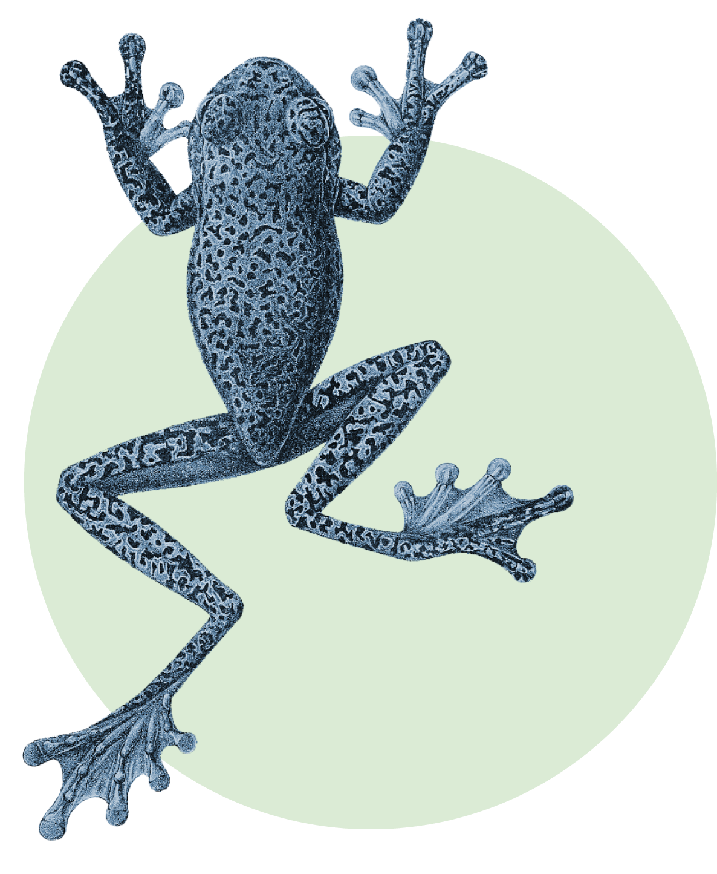
Delete before presenting Please read the instruction given in this section
Here is a list of the different resources you’ll find:
Overview slides-2023.pptx
Collages.pptx
Frequently used.pptx
Hubs.pptx
Icons.pptx
Infographics.pptx
For general instructions and guidelines about using these resources, refer to Instructions.pptx.

Slide 3

Delete before presenting Please read the instruction given in this section
In case that the fonts are not successfully embedded in the template, please install Rubik and Bitter on your local machine to ensure consistent display. Download the Zip archive from the fonts folder in the GitHub repository. To install,
Windows users: select the font files, right-click and select Install
Mac users: select the font files, control-click and select Open with Font Book
Several of the ’standard’ GBIF slides that receive regular updates (e.g. ‘By the numbers’, literature tracking, and other charts) will be also published on gbif.org and updated every quarter.

Slide 4
Presentation title
Name | Role
Notes:
To change the background image: Right click on the background image > Format Background > Fill > Picture or texture fill > Picture source > Insert > From a file (or online) > select you image and press Open.

